Slide 1
Distance Measures, A simple image formation model & Color fundamentals and models.

Slide 2
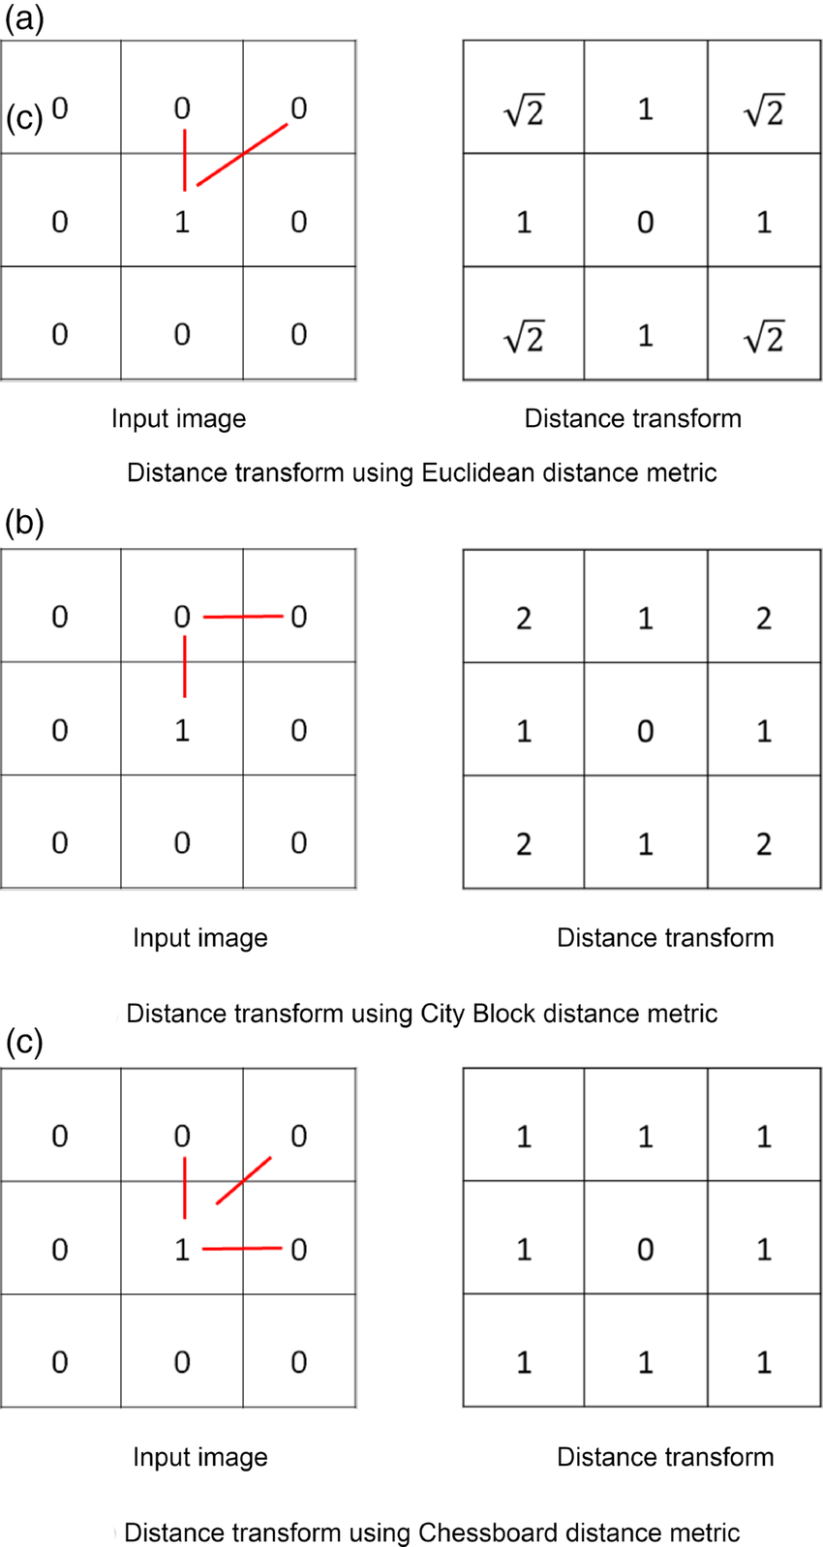
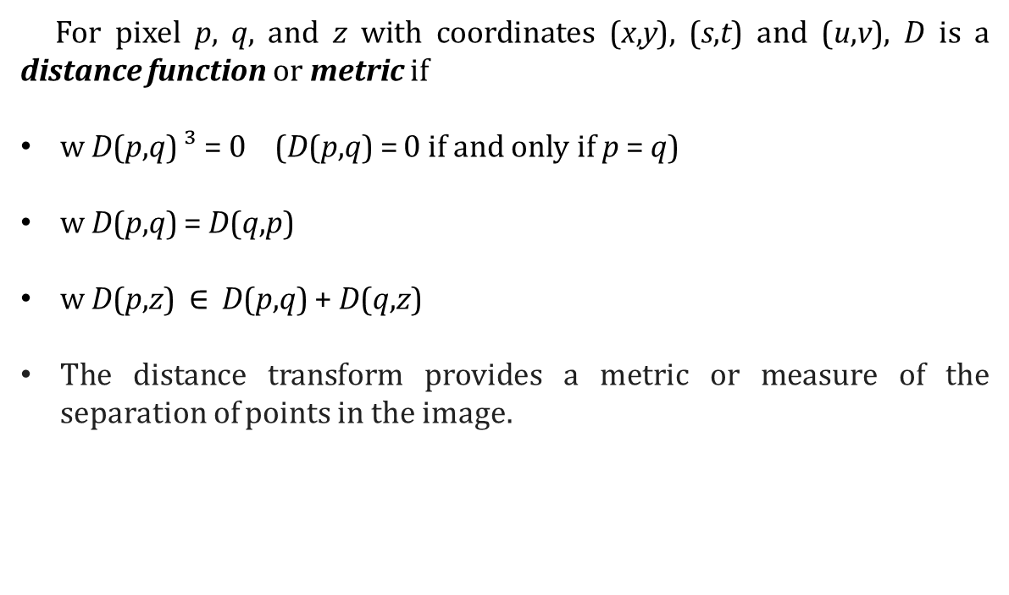
Distance Measures
For pixel p, q, and z with coordinates (x,y), (s,t) and (u,v), D is a distance function or metric if
w D(p,q) ³ = 0 (D(p,q) = 0 if and only if p = q)
w D(p,q) = D(q,p)
w D(p,z) $∈$ D(p,q) + D(q,z)
The distance transform provides a metric or measure of the separation of points in the image.
Euclidean Distance
City Block Distance
Chessboard Distance

Slide 3
Distance Measures
If we have 3 pixels: p,q,z respectively
p with (x,y) q with (s,t) z with (v,w)
Then:
A.D (p,q) ≥ 0 ,D(p,q) = 0 iff p = q
B.D(p,q) = D(q,p)
C.D(p,z) ≤ D(p,q) + D(q,z)

Slide 4
Example:
Compute the distance between the two pixels using the three distances :
q:(1,1)
P: (2,2)
Euclidian distance : ((1-2)²+(1-2)²)^{1/2} = sqrt(2).
D4(City Block distance): |1-2| +|1-2| =2
D8(chessboard distance ) : max(|1-2|,|1-2|)= 1
(because it is one of the 8-neighbors )
1
2
3
1
2
q
 | p
3

Slide 5
Distance measures
Example :
Use the city block distance to prove 4- neighbors ?
1 2 3
1
 | d
a | p | c
 | b
Pixel A : | 2-2| + |1-2| = 1 Pixel B: | 3-2|+|2-2|= 1 Pixel C: |2-2|+|2-3| =1 Pixel D: |1-2| + |2-2| = 1
2
3
Now as a homework try the chessboard distance to proof the 8- neighbors!!!!

Slide 6
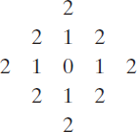
Distance Measures
Example:
The pixels with distance D₄ ≤ 2 from (x,y) form the following contours of constant distance.
The pixels with D₄ = 1 are the 4-neighbors of (x,y)

Slide 7
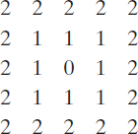
Distance Measures
Example:
D₈ distance ≤ 2 from (x,y) form the following contours of constant distance.
D8 = 1 are the 8-neighbors of (x,y)

Slide 8
Distance Measures
Dm distance:
is defined as the shortest m-path between the points.
In this case, the distance between two pixels will depend on the values of the pixels along the path, as well as the values of their neighbors.

Slide 9

Distance Measures
Example:
Consider the following arrangement of pixels and assume that p, p₂, and p₄ have value 1 and that p₁ and p₃ can have a value of 0 or 1
Suppose that we consider the adjacency of pixels values 1 (i.e. V = {1})

Slide 10

Distance Measures
Cont. Example:
Now, to compute the D_{m} between points p and p₄
Here we have 4 cases:
Case1: If p₁ =0 and p₃ = 0 The length of the shortest m-path (the D_{m} distance) is 2 (p, p₂, p₄)

Slide 11

Distance Measures
Cont. Example:
Case2: If p₁ =1 and p₃ = 0
then, the length of the shortest path will be 3 (p, p₁, p₂, p₄)

Slide 12

Distance Measures
Cont. Example:
Case3: If p₁ =0 and p₃ = 1
The same applies here, and the shortest – m-path will be 3 (p, p₂, p₃, p₄)

Slide 13

Distance Measures
Cont. Example:
Case4: If p₁ =1 and p₃ = 1
The length of the shortest m-path will be 4 (p, p₁ , p₂, p₃, p₄)

Slide 14
A Simple Image Formation Model

Slide 15
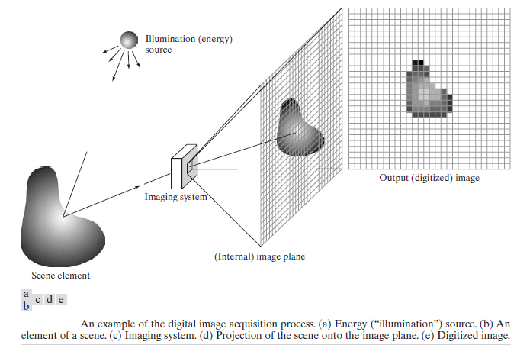
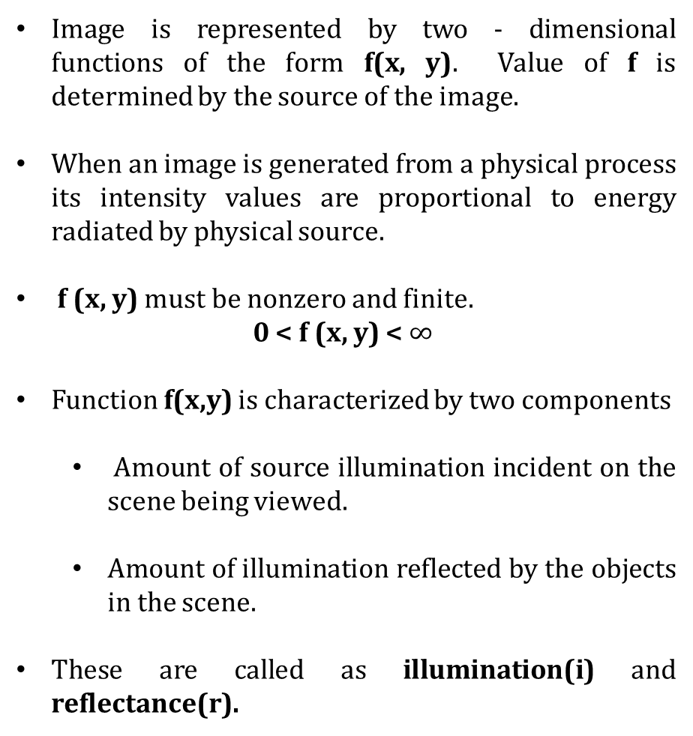
A Simple Image Formation Model
Image is represented by two - dimensional functions of the form f(x, y). Value of f is determined by the source of the image.
When an image is generated from a physical process its intensity values are proportional to energy radiated by physical source.
f (x, y) must be nonzero and finite.
0 < f (x, y) < $∞$
Function f(x,y) is characterized by two components
Amount of source illumination incident on the scene being viewed.
Amount of illumination reflected by the objects in the scene.
These are called as illumination(i) and reflectance(r).

Slide 16
A Simple Image Formation Model (Contd.)
Components represented by, i (x, y) and r (x, y)
Its product are, f (x, y) = i (x, y) r (x, y)
where0 <i (x, y) < ∞ and 0 < r (x, y) < 1
Reflectance is bounded by 0 (total absorption), 1 (total reflectance)
Nature of i (x, y) is determined by illumination source and r (x, y) is determined by characteristics of the imaged objects.

Slide 17
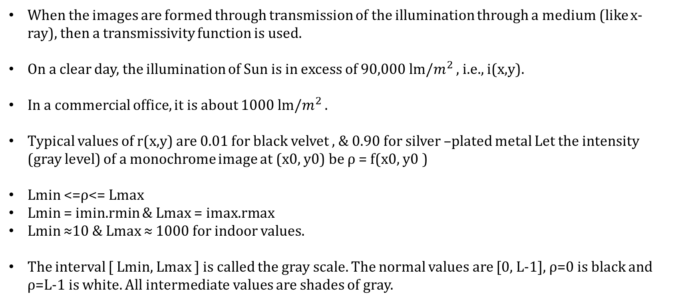
Example
When the images are formed through transmission of the illumination through a medium (like x- ray), then a transmissivity function is used.
On a clear day, the illumination of Sun is in excess of 90,000 lm/$m^{2}$ , i.e., i(x,y).
In a commercial office, it is about 1000 lm/$m^{2}$ .
Typical values of r(x,y) are 0.01 for black velvet , & 0.90 for silver –plated metal Let the intensity (gray level) of a monochrome image at (x0, y0) be ρ = f(x0, y0 )
Lmin <=ρ<= Lmax
Lmin = imin.rmin & Lmax = imax.rmax
Lmin ≈10 & Lmax ≈ 1000 for indoor values.
The interval [ Lmin, Lmax ] is called the gray scale. The normal values are [0, L-1], ρ=0 is black and ρ=L-1 is white. All intermediate values are shades of gray.

Slide 18
Color fundamentals and models

Slide 19
Color fundamentals
Physical phenomenon
Physical nature of color is known
Psysio-psychological phenomenon
How human brain perceive and interpret color?

Slide 20
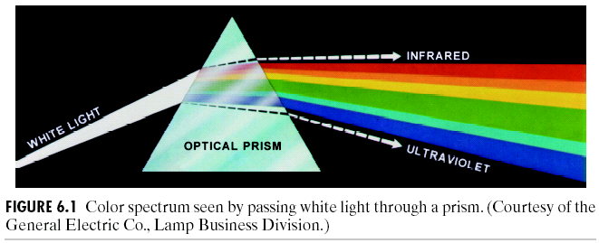
Color fundamentals (cont.)
1666, Isaac Newton

Slide 21
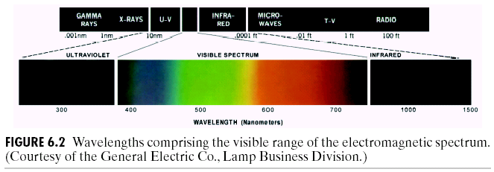
Visible light
Chromatic light span the electromagnetic spectrum (EM) from 400 to 700 nm

Slide 22
Color fundamentals (cont.)
The color that human perceive in an object = the light reflected from the object
scene
Illumination source
reflection
eye

Slide 23
Physical quantities to describe a chromatic light source
Radiance: total amount of energy that flow from the light source, measured in watts (W)
Luminance: amount of energy an observer perceives from a light source, measured in lumens
Far infrared light: high radiance, but 0 luminance
Brightness: subjective descriptor that is hard to measure, similar to the achromatic notion of intensity

Slide 24
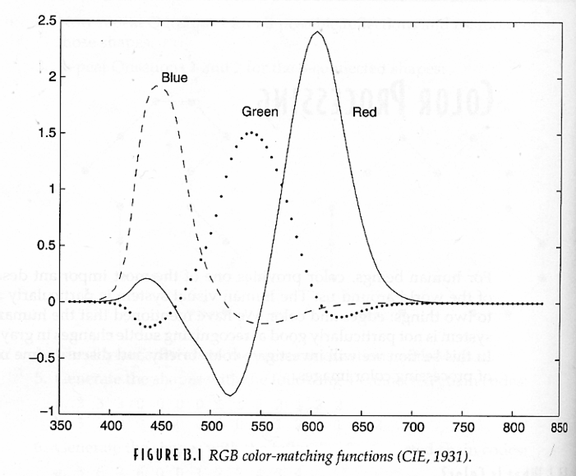
How human eyes sense light?
6~7M Cones are the sensors in the eye
3 principal sensing categories in eyes
Red light 65%, green light 33%, and blue light 2%

Slide 25
Primary and secondary colors
In 1931, CIE(International Commission on Illumination) defines specific wavelength values to the primary colors
B = 435.8 nm, G = 546.1 nm, R = 700 nm
However, we know that no single color may be called red, green, or blue
Secondary colors: G+B=Cyan, R+G=Yellow, R+B=Magenta

Slide 26
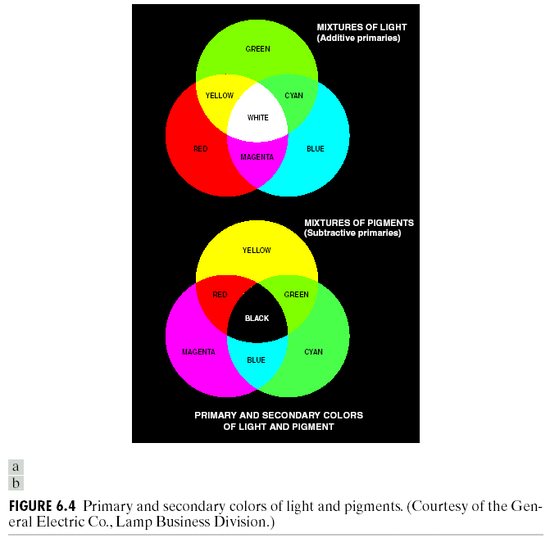

Primary and secondary colors(Contd.)

Slide 27
Primary colors of light v.s. primary colors of pigments
Primary color of pigments
Color that subtracts or absorbs a primary color of light and reflects or transmits the other two
Color of light: R G B
Color of pigments: absorb R absorb G absorb B
Cyan Magenta Yellow

Slide 28
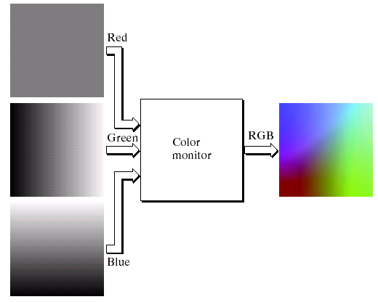
Application of additive nature of light colors
Color TV

Slide 29
CIE XYZ model
RGB -> CIE XYZ model
Normalized tristimulus values
=> x+y+z=1. Thus, x, y (chromaticity coordinate) is
enough to describe all colors

Slide 30
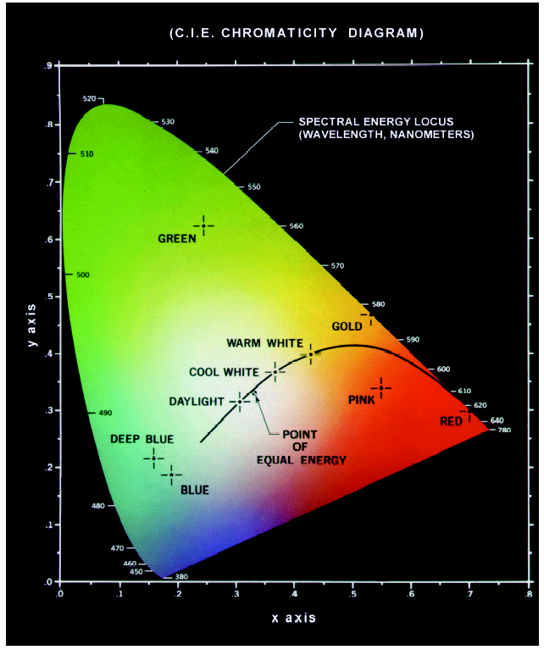

Slide 31
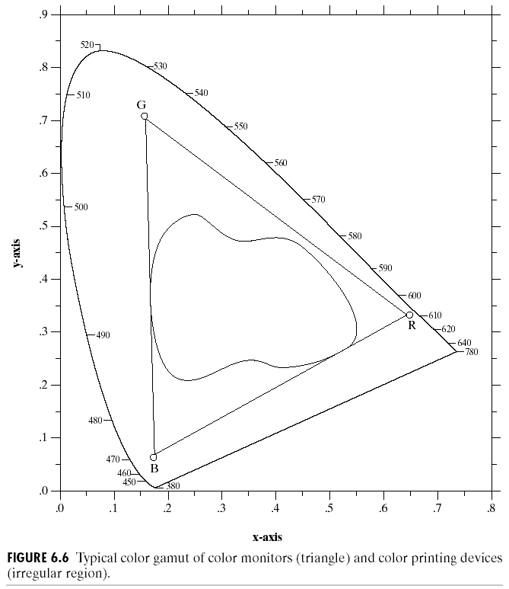
By additivity of colors:
Any color inside the
triangle can be produced
by combinations of the
three initial colors
RGB gamut of
monitors
Color gamut of
printers

Slide 32
Color models
Color model, color space, color system
Specify colors in a standard way
A coordinate system that each color is represented by a single point
RGB model
CYM model
CYMK model
HSI model
Suitable for hardware or
applications
- match the human description

Slide 33
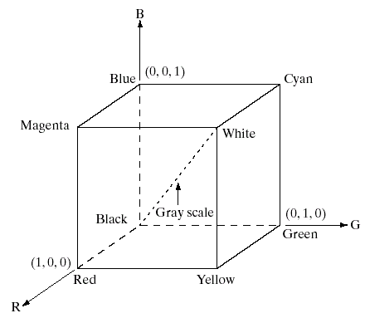
RGB color model

Slide 34
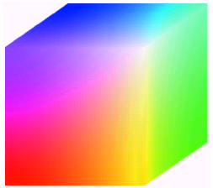
Pixel depth
Pixel depth: the number of bits used to represent each pixel in RGB space
Full-color image: 24-bit RGB color image
(R, G, B) = (8 bits, 8 bits, 8 bits)

Slide 35
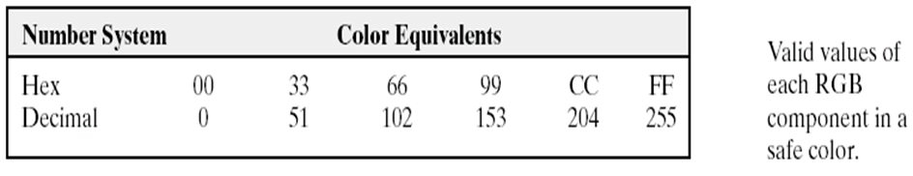
Safe RGB colors
Subset of colors is enough for some application
Safe RGB colors (safe Web colors, safe browser colors)
(6)³ = 216

Slide 36
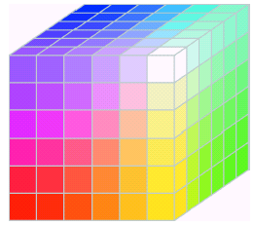
Safe RGB color (cont.)
Full color cube
Safe color cube

Slide 37
CMY model (+Black = CMYK)
CMY: secondary colors of light, or primary colors of pigments
Used to generate hardcopy output

Slide 38
HSI color model
Will you describe a color using its R, G, B components?
Human describe a color by its hue, saturation, and brightness
Hue : color attribute
Saturation: purity of color (white->0, primary color->1)
Brightness: achromatic notion of intensity

Slide 39
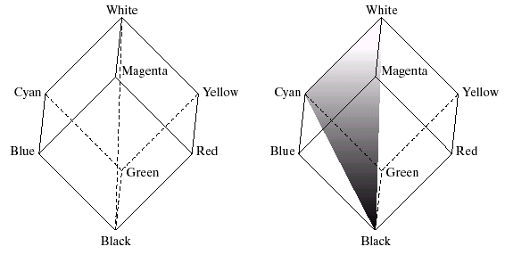
HSI color model (cont.)
RGB -> HSI model
Colors on this triangle
Have the same hue
Intensity
line
saturation

Slide 40
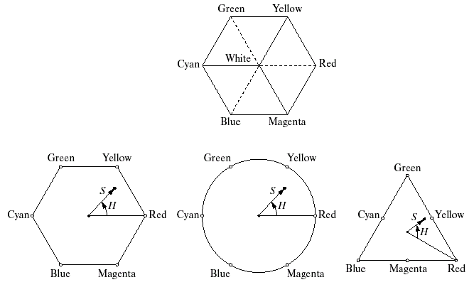
HSI model: hue and saturation

Slide 41
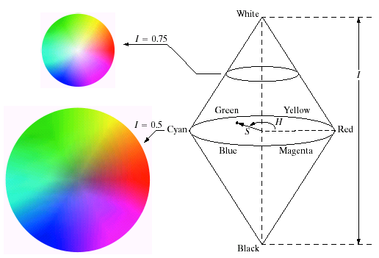
HSI model

Slide 42
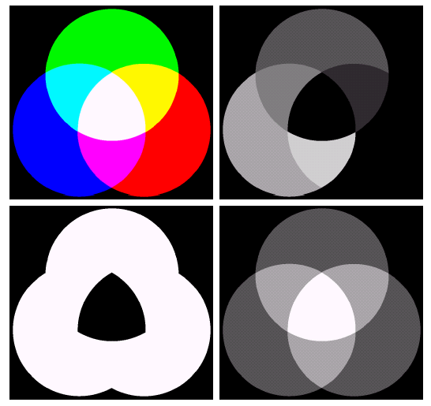
HSI component images
R,G,B
Hue
intensity
saturation

Slide 43
THANK YOU

